Slide 1
Sets, Tuples & Dictionary

Slide 2
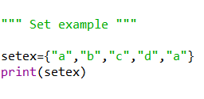

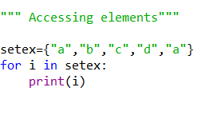


Sets
Immutable
No Duplication
Unordered
Result:

Slide 3
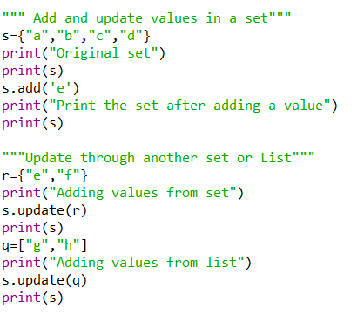
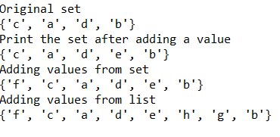
Sets- Add and Update
Result:

Slide 4
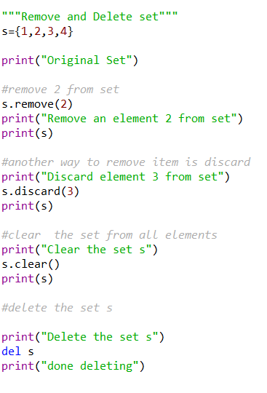
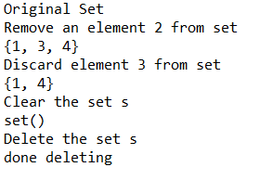
Sets - Remove
Result:

Slide 5
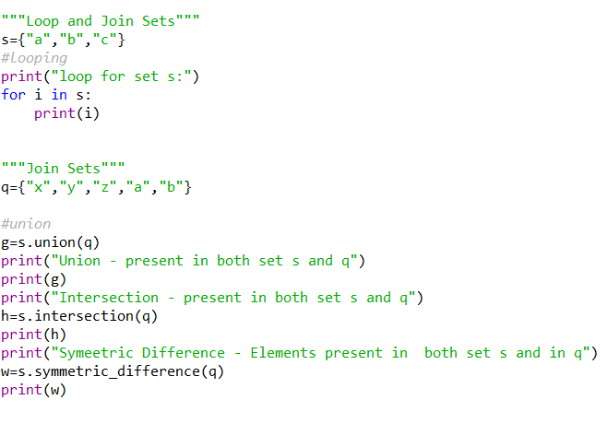
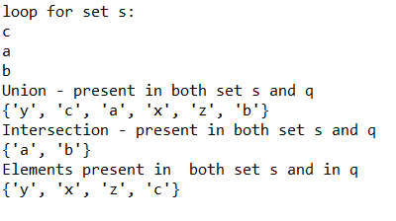
Sets - Loop & Join
Result:

Slide 6
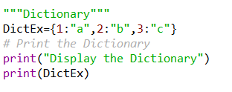

Dictionaries
Key/value pair
Ordered
Changeable
No Duplication
Result:

Slide 7
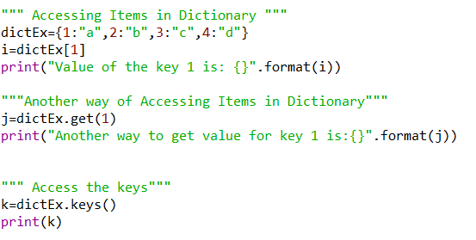

Dictionary – Accessing Items
Result:

Slide 8
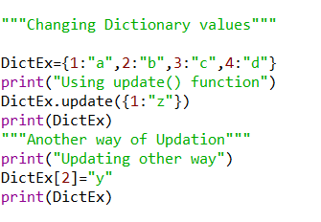
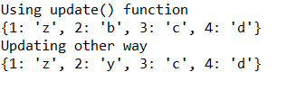
Dictionary – Updating Values
Result:

Slide 9
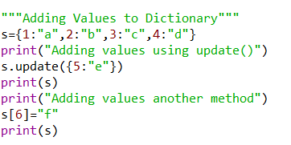

Dictionary – Adding Values
Result:

Slide 10
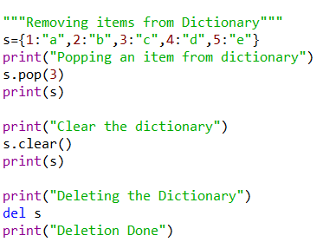
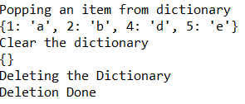
Dictionary – Removing item
Result:

Slide 11
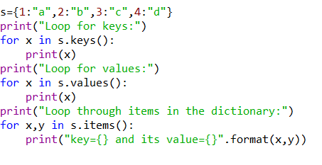
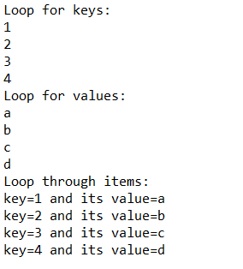
Dictionary Loops
Result:

Slide 12
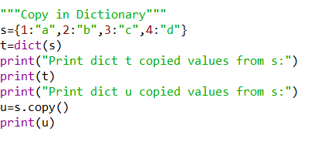

Dictionary - Copy
Result:

Slide 13
Sample Programs - Dictionary
1. Write a Python script to sort (ascending and descending) a dictionary by value.
2. Write a Python script to add a key to a dictionary.
Sample Dictionary : {0: 10, 1: 20} Expected Result : {0: 10, 1: 20, 2: 30}
3. Write a Python script to concatenate following dictionaries to create a new one.
Sample Dictionary : dic1={1:10, 2:20} dic2={3:30, 4:40} dic3={5:50,6:60} Expected Result : {1: 10, 2: 20, 3: 30, 4: 40, 5: 50, 6: 60}
4. Write a Python script to check whether a given key already exists in a dictionary.
5. Write a Python program to iterate over dictionaries using for loops.
6. Write a Python script to generate and print a dictionary that contains a number (between 1 and n) in the form (x, x*x). Sample Dictionary ( n = 5) : Expected Output : {1: 1, 2: 4, 3: 9, 4: 16, 5: 25}
7. Write a Python script to print a dictionary where the keys are numbers between 1 and 15 (both included) and the values are square of keys. Sample Dictionary {1: 1, 2: 4, 3: 9, 4: 16, 5: 25, 6: 36, 7: 49, 8: 64, 9: 81, 10: 100, 11: 121, 12: 144, 13: 169, 14: 196, 15: 225}
8. Write a Python script to merge two Python dictionaries.
9. Write a Python program to iterate over dictionaries using for loops.
10. Write a Python program to sum all the items in a dictionary.
11. Write a Python program to multiply all the items in a dictionary.
12. Write a Python program to remove a key from a dictionary.
13. Write a Python program to map two lists into a dictionary.
14. Write a Python program to sort a dictionary by key.
15. Write a Python program to get the maximum and minimum value in a dictionary.
16. Write a Python program to get a dictionary from an object's fields.
17. Write a Python program to remove duplicates from Dictionary.
18. Write a Python program to check a dictionary is empty or not.
19. Write a Python program to combine two dictionary adding values for common keys. d1 = {'a': 100, 'b': 200, 'c':300} d2 = {'a': 300, 'b': 200, 'd':400} Sample output: Counter({'a': 400, 'b': 400, 'd': 400, 'c': 300})
20. Write a Python program to print all unique values in a dictionary. Sample Data : [{"V":"S001"}, {"V": "S002"}, {"VI": "S001"}, {"VI": "S005"}, {"VII":"S005"}, {"V":"S009"},{"VIII":"S007"}] Expected Output : Unique Values: {'S005', 'S002', 'S007', 'S001', 'S009'}

Slide 14
21. Write a Python program to create and display all combinations of letters, selecting each letter from a different key in a dictionary. Sample data : {'1':['a','b'], '2':['c','d']} Expected Output: ac ad bc bd
22. Write a Python program to find the highest 3 values of corresponding keys in a dictionary.
23. Write a Python program to combine values in python list of dictionaries. Sample data: [{'item': 'item1', 'amount': 400}, {'item': 'item2', 'amount': 300}, {'item': 'item1', 'amount': 750}] Expected Output: Counter({'item1': 1150, 'item2': 300})
24. Write a Python program to create a dictionary from a string. Note: Track the count of the letters from the string. Sample string : 'w3resource' Expected output: {'w': 1, '3': 1, 'r': 2, 'e': 2, 's': 1, 'o': 1, 'u': 1, 'c': 1}
25. Write a Python program to print a dictionary in table format
26. Write a Python program to count the values associated with key in a dictionary. Expected Output: 6 2
27. Write a Python program to convert a list into a nested dictionary of keys.
28. Write a Python program to sort a list alphabetically in a dictionary.
29. Write a Python program to remove spaces from dictionary keys.
30. Write a Python program to get the top three items in a shop. Sample data: {'item1': 45.50, 'item2':35, 'item3': 41.30, 'item4':55, 'item5': 24} Expected Output: item4 55 item1 45.5 item3 41.3
31. Write a Python program to get the key, value and item in a dictionary.
32. Write a Python program to print a dictionary line by line.
33. Write a Python program to check multiple keys exists in a dictionary.
34. Write a Python program to count number of items in a dictionary value that is a list.
35. Write a Python program to sort Counter by value. Sample data : {'Math':81, 'Physics':83, 'Chemistry':87} Expected data: [('Chemistry', 87), ('Physics', 83), ('Math', 81)]

Slide 15
36. Write a Python program to create a dictionary from two lists without losing duplicate values. Sample lists: ['Class-V', 'Class-VI', 'Class-VII', 'Class-VIII'], [1, 2, 2, 3] Expected Output: defaultdict(<class 'set'>, {'Class-V': {1}, 'Class-VI': {2}, 'Class-VII': {2}, 'Class-VIII': {3}})
37. Write a Python program to replace dictionary values with their average.
38. Write a Python program to match key values in two dictionaries. Sample dictionary: {'key1': 1, 'key2': 3, 'key3': 2}, {'key1': 1, 'key2': 2} Expected output: key1: 1 is present in both x and y
39. Write a Python program to store a given dictionary in a json file. Original dictionary: {'students': [{'firstName': 'Nikki', 'lastName': 'Roysden'}, {'firstName': 'Mervin', 'lastName': 'Friedland'}, {'firstName': 'Aron ', 'lastName': 'Wilkins'}], 'teachers': [{'firstName': 'Amberly', 'lastName': 'Calico'}, {'firstName': 'Regine', 'lastName': 'Agtarap'}]} <class 'dict'> Json file to dictionary: {'students': [{'firstName': 'Nikki', 'lastName': 'Roysden'}, {'firstName': 'Mervin', 'lastName': 'Friedland'}, {'firstName': 'Aron ', 'lastName': 'Wilkins'}], 'teachers': [{'firstName': 'Amberly', 'lastName': 'Calico'}, {'firstName': 'Regine', 'lastName': 'Agtarap'}]}
40. Write a Python program to create a dictionary of keys x, y, and z where each key has as value a list from 11-20, 21-30, and 31-40 respectively. Access the fifth value of each key from the dictionary. {'x': [11, 12, 13, 14, 15, 16, 17, 18, 19], 'y': [21, 22, 23, 24, 25, 26, 27, 28, 29], 'z': [31, 32, 33, 34, 35, 36, 37, 38, 39]} 15 25 35 x has value [11, 12, 13, 14, 15, 16, 17, 18, 19] y has value [21, 22, 23, 24, 25, 26, 27, 28, 29] z has value [31, 32, 33, 34, 35, 36, 37, 38, 39]
41. Write a Python program to drop empty Items from a given Dictionary. Original Dictionary: {'c1': 'Red', 'c2': 'Green', 'c3': None} New Dictionary after dropping empty items: {'c1': 'Red', 'c2': 'Green’}
42. Write a Python program to filter a dictionary based on values. Original Dictionary: {'Cierra Vega': 175, 'Alden Cantrell': 180, 'Kierra Gentry': 165, 'Pierre Cox': 190} Marks greater than 170: {'Cierra Vega': 175, 'Alden Cantrell': 180, 'Pierre Cox': 190}
43. Write a Python program to convert more than one list to nested dictionary. Original strings: ['S001', 'S002', 'S003', 'S004'] ['Adina Park', 'Leyton Marsh', 'Duncan Boyle', 'Saim Richards'] [85, 98, 89, 92] Nested dictionary: [{'S001': {'Adina Park': 85}}, {'S002': {'Leyton Marsh': 98}}, {'S003': {'Duncan Boyle': 89}}, {'S004': {'Saim Richards': 92}}]
44. Write a Python program to filter the height and width of students, which are stored in a dictionary. Original Dictionary: {'Cierra Vega': (6.2, 70), 'Alden Cantrell': (5.9, 65), 'Kierra Gentry': (6.0, 68), 'Pierre Cox': (5.8, 66)} Height > 6ft and Weight> 70kg: {'Cierra Vega': (6.2, 70)}
45. Write a Python program to check all values are same in a dictionary. Original Dictionary: {'Cierra Vega': 12, 'Alden Cantrell': 12, 'Kierra Gentry': 12, 'Pierre Cox': 12} Check all are 12 in the dictionary. True Check all are 10 in the dictionary. False

Slide 16
46. Write a Python program to create a dictionary grouping a sequence of key-value pairs into a dictionary of lists. Original list: [('yellow', 1), ('blue', 2), ('yellow', 3), ('blue', 4), ('red', 1)] Grouping a sequence of key-value pairs into a dictionary of lists: {'yellow': [1, 3], 'blue': [2, 4], 'red': [1]}
47. Write a Python program to split a given dictionary of lists into list of dictionaries. Original dictionary of lists: {'Science': [88, 89, 62, 95], 'Language': [77, 78, 84, 80]} Split said dictionary of lists into list of dictionaries: [{'Science': 88, 'Language': 77}, {'Science': 89, 'Language': 78}, {'Science': 62, 'Language': 84}, {'Science': 95, 'Language': 80}]
48. Write a Python program to remove a specified dictionary from a given list. Original list of dictionary: [{'id': '#FF0000', 'color': 'Red'}, {'id': '#800000', 'color': 'Maroon'}, {'id': '#FFFF00', 'color': 'Yellow'}, {'id': '#808000', 'color': 'Olive'}] Remove id #FF0000 from the said list of dictionary: [{'id': '#800000', 'color': 'Maroon'}, {'id': '#FFFF00', 'color': 'Yellow'}, {'id': '#808000', 'color': 'Olive’}]
49. Write a Python program to convert string values of a given dictionary, into integer/float datatypes. Original list: [{'x': '10', 'y': '20', 'z': '30'}, {'p': '40', 'q': '50', 'r': '60'}] String values of a given dictionary, into integer types: [{'x': 10, 'y': 20, 'z': 30}, {'p': 40, 'q': 50, 'r': 60}] Original list: [{'x': '10.12', 'y': '20.23', 'z': '30'}, {'p': '40.00', 'q': '50.19', 'r': '60.99'}] String values of a given dictionary, into float types: [{'x': 10.12, 'y': 20.23, 'z': 30.0}, {'p': 40.0, 'q': 50.19, 'r': 60.99}]
50. A Python Dictionary contains List as value. Write a Python program to clear the list values in the said dictionary. Original Dictionary: {'C1': [10, 20, 30], 'C2': [20, 30, 40], 'C3': [12, 34]} Clear the list values in the said dictionary: {'C1': [], 'C2': [], 'C3': []}
51. A Python Dictionary contains List as value. Write a Python program to update the list values in the said dictionary. Original Dictionary: {'Math': [88, 89, 90], 'Physics': [92, 94, 89], 'Chemistry': [90, 87, 93]} Update the list values of the said dictionary: {'Math': [89, 90, 91], 'Physics': [90, 92, 87], 'Chemistry': [90, 87, 93]}
52. Write a Python program to extract a list of values from a given list of dictionaries. Original Dictionary: [{'Math': 90, 'Science': 92}, {'Math': 89, 'Science': 94}, {'Math': 92, 'Science': 88}] Extract a list of values from said list of dictionaries where subject = Science [92, 94, 88] Original Dictionary: [{'Math': 90, 'Science': 92}, {'Math': 89, 'Science': 94}, {'Math': 92, 'Science': 88}] Extract a list of values from said list of dictionaries where subject = Math [90, 89, 92]
53. Write a Python program to find the length of a given dictionary values. Original Dictionary: {1: 'red', 2: 'green', 3: 'black', 4: 'white', 5: 'black'} Length of dictionary values: {'red': 3, 'green': 5, 'black': 5, 'white': 5} Original Dictionary: {'1': 'Austin Little', '2': 'Natasha Howard', '3': 'Alfred Mullins', '4': 'Jamie Rowe'} Length of dictionary values: {'Austin Little': 13, 'Natasha Howard': 14, 'Alfred Mullins': 14, 'Jamie Rowe': 10}

Slide 17
54. Write a Python program to get the depth of a dictionary. Expected Output: 4
55. Write a Python program to access dictionary key's element by index.
Expected Output: physics math chemistry
56. Write a Python program to convert a given dictionary into a list of lists. Original Dictionary: {1: 'red', 2: 'green', 3: 'black', 4: 'white', 5: 'black'} Convert the said dictionary into a list of lists: [[1, 'red'], [2, 'green'], [3, 'black'], [4, 'white'], [5, 'black']] Original Dictionary: {'1': 'Austin Little', '2': 'Natasha Howard', '3': 'Alfred Mullins', '4': 'Jamie Rowe'} Convert the said dictionary into a list of lists: [['1', 'Austin Little'], ['2', 'Natasha Howard'], ['3', 'Alfred Mullins'], ['4', 'Jamie Rowe’]]
57. Write a Python program to filter even numbers from a given dictionary values. Original Dictionary: {'V': [1, 4, 6, 10], 'VI': [1, 4, 12], 'VII': [1, 3, 8]} Filter even numbers from said dictionary values: {'V': [4, 6, 10], 'VI': [4, 12], 'VII': [8]} Original Dictionary: {'V': [1, 3, 5], 'VI': [1, 5], 'VII': [2, 7, 9]} Filter even numbers from said dictionary values: {'V': [], 'VI': [], 'VII': [2]}
58. Write a Python program to get all combinations of key-value pairs in a given dictionary. Original Dictionary: {'V': [1, 4, 6, 10], 'VI': [1, 4, 12], 'VII': [1, 3, 8]} Combinations of key-value pairs of the said dictionary: [{'V': [1, 4, 6, 10], 'VI': [1, 4, 12]}, {'V': [1, 4, 6, 10], 'VII': [1, 3, 8]}, {'VI': [1, 4, 12], 'VII': [1, 3, 8]}] Original Dictionary: {'V': [1, 3, 5], 'VI': [1, 5]} Combinations of key-value pairs of the said dictionary: [{'V': [1, 3, 5], 'VI': [1, 5]}]
59. Write a Python program to find the specified number of maximum values in a given dictionary. Original Dictionary: {'a': 5, 'b': 14, 'c': 32, 'd': 35, 'e': 24, 'f': 100, 'g': 57, 'h': 8, 'i': 100} 1 maximum value(s) in the said dictionary: ['f'] 2 maximum value(s) in the said dictionary: ['f', 'i'] 5 maximum value(s) in the said dictionary: ['f', 'i', 'g', 'd', 'c’]
60. Write a Python program to find shortest list of values with the keys in a given dictionary Original Dictionary: {'V': [10, 12], 'VI': [10], 'VII': [10, 20, 30, 40], 'VIII': [20], 'IX': [10, 30, 50, 70], 'X': [80]} Shortest list of values with the keys of the said dictionary: ['VI', 'VIII', 'X’]
61. Write a Python program to count the frequency in a given dictionary. Original Dictionary: {'V': 10, 'VI': 10, 'VII': 40, 'VIII': 20, 'IX': 70, 'X': 80, 'XI': 40, 'XII': 20} Count the frequency of the said dictionary: Counter({10: 2, 40: 2, 20: 2, 70: 1, 80: 1})

Slide 18
64. Write a Python program to create a key-value list pairings in a given dictionary. Original dictionary: {1: ['Jean Castro'], 2: ['Lula Powell'], 3: ['Brian Howell'], 4: ['Lynne Foster'], 5: ['Zachary Simon']} A key-value list pairings of the said dictionary: [{1: 'Jean Castro', 2: 'Lula Powell', 3: 'Brian Howell', 4: 'Lynne Foster', 5: 'Zachary Simon’}]
65. Write a Python program to get the total length of all values of a given dictionary with string values. Original dictionary: {'#FF0000': 'Red', '#800000': 'Maroon', '#FFFF00': 'Yellow', '#808000': 'Olive'} Total length of all values of the said dictionary with string values: 20
66. Write a Python program to check if a specific Key and a value exist in a dictionary. Original dictionary: [{'student_id': 1, 'name': 'Jean Castro', 'class': 'V'}, {'student_id': 2, 'name': 'Lula Powell', 'class': 'V'}, {'student_id': 3, 'name': 'Brian Howell', 'class': 'VI'}, {'student_id': 4, 'name': 'Lynne Foster', 'class': 'VI'}, {'student_id': 5, 'name': 'Zachary Simon', 'class': 'VII'}] Check if a specific Key and a value exist in the said dictionary: True True True False False False
62. Write a Python program to extract values from a given dictionaries and create a list of lists from those values. Original Dictionary: [{'student_id': 1, 'name': 'Jean Castro', 'class': 'V'}, {'student_id': 2, 'name': 'Lula Powell', 'class': 'V'}, {'student_id': 3, 'name': 'Brian Howell', 'class': 'VI'}, {'student_id': 4, 'name': 'Lynne Foster', 'class': 'VI'}, {'student_id': 5, 'name': 'Zachary Simon', 'class': 'VII'}] Extract values from the said dictionarie and create a list of lists using those values: [[1, 'Jean Castro', 'V'], [2, 'Lula Powell', 'V'], [3, 'Brian Howell', 'VI'], [4, 'Lynne Foster', 'VI'], [5, 'Zachary Simon', 'VII']] [[1, 'Jean Castro'], [2, 'Lula Powell'], [3, 'Brian Howell'], [4, 'Lynne Foster'], [5, 'Zachary Simon']] [['Jean Castro', 'V'], ['Lula Powell', 'V'], ['Brian Howell', 'VI'], ['Lynne Foster', 'VI'], ['Zachary Simon', 'VII’]]
63. Write a Python program to convert a given list of lists to a dictionary. Original list of lists: [[1, 'Jean Castro', 'V'], [2, 'Lula Powell', 'V'], [3, 'Brian Howell', 'VI'], [4, 'Lynne Foster', 'VI'], [5, 'Zachary Simon', 'VII']] Convert the said list of lists to a dictionary: {1: ['Jean Castro', 'V'], 2: ['Lula Powell', 'V'], 3: ['Brian Howell', 'VI'], 4: ['Lynne Foster', 'VI'], 5: ['Zachary Simon', 'VII']}

Slide 19
Tuples
1. Write a Python program to create a tuple.
2. Write a Python program to create a tuple with different data types
3. Write a Python program to create a tuple with numbers and print one item
4. Write a Python program to unpack a tuple in several variables.
5. Write a Python program to add an item in a tuple.
6. Write a Python program to convert a tuple to a string.
7. Write a Python program to get the 4th element and 4th element from last of a tuple.
8. Write a Python program to create the colon of a tuple.
9. Write a Python program to find the repeated items of a tuple.
10. Write a Python program to check whether an element exists within a tuple.
11. Write a Python program to convert a list to a tuple.
12. Write a Python program to remove an item from a tuple.
13. Write a Python program to slice a tuple.
14. Write a Python program to find the index of an item of a tuple.
15. Write a Python program to find the length of a tuple.
16. Write a Python program to convert a tuple to a dictionary.
17. Write a Python program to unzip a list of tuples into individual lists.
18. Write a Python program to reverse a tuple.
19. Write a Python program to convert a list of tuples into a dictionary.
20. Write a Python program to print a tuple with string formatting. Sample tuple : (100, 200, 300) Output : This is a tuple (100, 200, 300)

Slide 20
21. Write a Python program to replace last value of tuples in a list. Sample list: [(10, 20, 40), (40, 50, 60), (70, 80, 90)] Expected Output: [(10, 20, 100), (40, 50, 100), (70, 80, 100)]
22. Write a Python program to remove an empty tuple(s) from a list of tuples. Sample data: [(), (), ('',), ('a', 'b'), ('a', 'b', 'c'), ('d')] Expected output: [('',), ('a', 'b'), ('a', 'b', 'c'), 'd']
23. Write a Python program to sort a tuple by its float element. Sample data: [('item1', '12.20'), ('item2', '15.10'), ('item3', '24.5')] Expected Output: [('item3', '24.5'), ('item2', '15.10'), ('item1', '12.20’)]
24. Write a Python program to count the elements in a list until an element is a tuple.
25. Write a Python program convert a given string list to a tuple. Original string: python 3.0 <class 'str'> Convert the said string to a tuple: ('p', 'y', 't', 'h', 'o', 'n', '3', '.', '0') <class 'tuple’>
26. Write a Python program calculate the product, multiplying all the numbers of a given tuple. Original Tuple: (4, 3, 2, 2, -1, 18) Product - multiplying all the numbers of the said tuple: -864 Original Tuple: (2, 4, 8, 8, 3, 2, 9) Product - multiplying all the numbers of the said tuple: 27648
27. Write a Python program to calculate the average value of the numbers in a given tuple of tuples. Original Tuple: ((10, 10, 10, 12), (30, 45, 56, 45), (81, 80, 39, 32), (1, 2, 3, 4)) Average value of the numbers of the said tuple of tuples: [30.5, 34.25, 27.0, 23.25] Original Tuple: ((1, 1, -5), (30, -15, 56), (81, -60, -39), (-10, 2, 3)) Average value of the numbers of the said tuple of tuples: [25.5, -18.0, 3.75]
28. Write a Python program to convert a tuple of string values to a tuple of integer values. Original tuple values: (('333', '33'), ('1416', '55')) New tuple values: ((333, 33), (1416, 55))
29. Write a Python program to convert a given tuple of positive integers into an integer. Original tuple: (1, 2, 3) Convert the said tuple of positive integers into an integer: 123 Original tuple: (10, 20, 40, 5, 70) Convert the said tuple of positive integers into an integer: 102040570

Slide 21
30. Write a Python program to check if a specified element presents in a tuple of tuples. Original list: (('Red', 'White', 'Blue'), ('Green', 'Pink', 'Purple'), ('Orange', 'Yellow', 'Lime')) Check if White presenet in said tuple of tuples! True Check if White presenet in said tuple of tuples! True Check if Olive presenet in said tuple of tuples! False
31. Write a Python program to compute element-wise sum of given tuples. Original lists: (1, 2, 3, 4) (3, 5, 2, 1) (2, 2, 3, 1) Element-wise sum of the said tuples: (6, 9, 8, 6)
32. Write a Python program to compute the sum of all the elements of each tuple stored inside a list of tuples. Original list of tuples: [(1, 2), (2, 3), (3, 4)] Sum of all the elements of each tuple stored inside the said list of tuples: [3, 5, 7] Original list of tuples: [(1, 2, 6), (2, 3, -6), (3, 4), (2, 2, 2, 2)] Sum of all the elements of each tuple stored inside the said list of tuples: [9, -1, 7, 8]
33. Write a Python program to convert a given list of tuples to a list of lists. Original list of tuples: [(1, 2), (2, 3), (3, 4)] Convert the said list of tuples to a list of lists: [[1, 2], [2, 3], [3, 4]] Original list of tuples: [(1, 2), (2, 3, 5), (3, 4), (2, 3, 4, 2)] Convert the said list of tuples to a list of lists: [[1, 2], [2, 3, 5], [3, 4], [2, 3, 4, 2]]

Slide 22
Sets
1. Write a Python program to create a set.
2. Write a Python program to iterate over sets.
3. Write a Python program to add member(s) in a set.
4. Write a Python program to remove item(s) from set
5. Write a Python program to remove an item from a set if it is present in the set.
6. Write a Python program to create an intersection of sets.
7. Write a Python program to create a union of sets.
8. Write a Python program to create set difference.
9. Write a Python program to create a symmetric difference.
10. Write a Python program to check if a set is a subset of another set.
11. Write a Python program to create a shallow copy of sets.
Note : Shallow copy is a bit-wise copy of an object. A new object is created that has an exact copy of the values in the original object.
12. Write a Python program to clear a set
13. Write a Python program to use of frozensets. Note: Frozensets behave just like sets except they are immutable.
14. Write a Python program to find maximum and the minimum value in a set
15. Write a Python program to find the length of a set.
16. Write a Python program to check if a given value is present in a set or
17. Write a Python program to check if two given sets have no elements in common.
18. Write a Python program to check if a given set is superset of itself and superset of another given set.
19. Write a Python program to find the elements in a given set that are not in another set.
20. Write a Python program to check a given set has no elements in common with other given set
21. Write a Python program to remove the intersection of a 2nd set from the 1st set.

